Slide 1
System and Network Administration
TinyNet Essentials

Slide 2
Troubleshooting
Stop! Don’t Rush
Make one change at a time – test
Start at one end, move up or down the network layers
Document before and changes

Slide 3
Correcting Faults
Gather evidence
Make an informed guess
(just fix it, see if it works --
BUT be able to go back to the previous and original !!)
Try to reproduce the error

Slide 4
Diagnosis
Be systematic:
start with simple things, progressing to more complicated causes or factors
always eliminate the obvious first
use a log, conceptual map, etc.
gather information that can be subject to association and deduction
establish (recall) cause and effect
be able to go back to the previous and original

Slide 5
Problems?? Check the “4 peas”
Paths
can be fixed with a symlink
Permissions
on files and directories
appropriate owner and group
Ports
Service must be running!
Parsing (typos)
config files
cnames

Slide 6
Paths
/ root directory . here .. up one level
/tmp/foo absolute tmp/foo relative ../../foo
cd change directory mv move or rename
cd /etc
cd foo
cd ..
mv foo ofo rename
mv ofo /var/opt move
cd /var/opt/ofo
./myscript.sh execute a file stored here

Slide 7
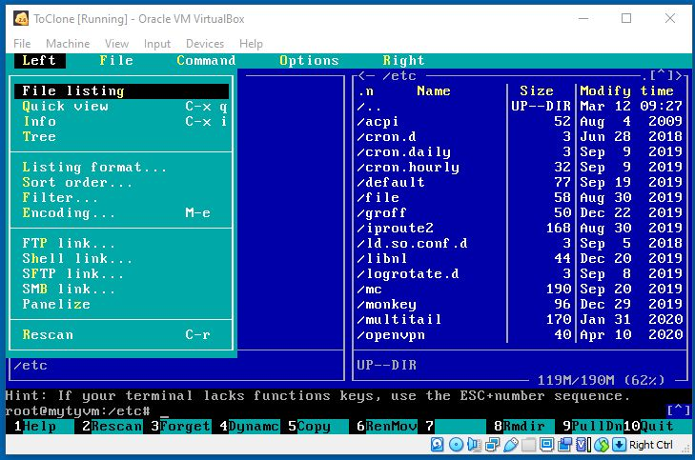
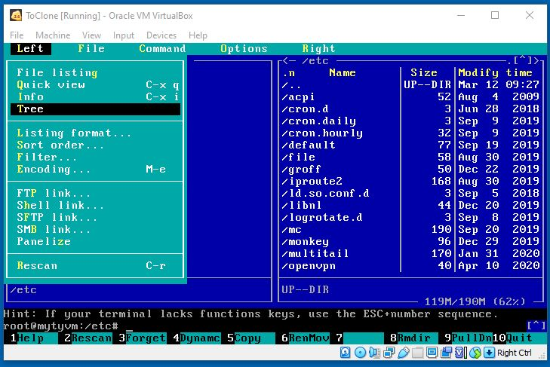
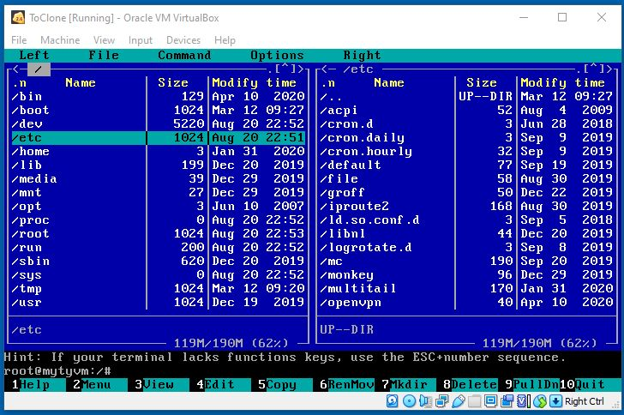
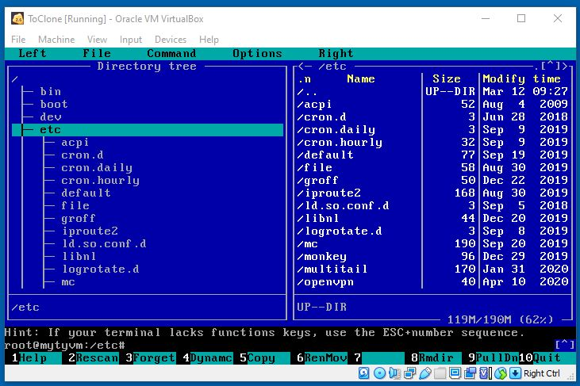
Press [F9] for the mc menu
Two directories
Tree and directory
Press [Tab] to switch sides

Slide 8
Symlink
Soft link or symbolic link (symlink): a small file that is a pointer to another file.
contains the path to the target file instead of a physical location on the hard disk; can point across partitions.
Note that removing the target file for a symbolic link makes the link useless.
Windows: shortcut (right click : file : properties)
used to create a new name to satisfy dependencies
a program that expects a file to be in another location
Symbolic links can generally save a lot of work

Slide 9
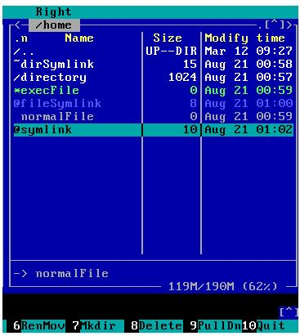
Up one Level
Curent Directory
Directory (Folder)
Executable File
C:\Users in Windows
is the equivalent of
/home in Linux
Symlink Target
Press [F9] for the mc menu

Slide 10
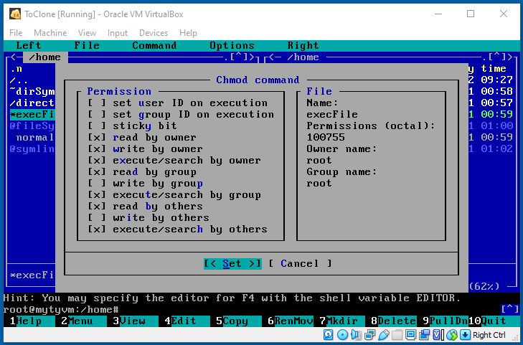
Linux Permissions
Not normally used
Numeric Representation:
Read = 4, Write = 2, Exec = 1
4 + 2 + 1 = 7
[Space] to turn on or off

Slide 11
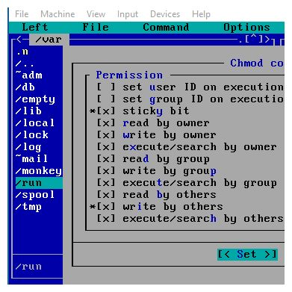
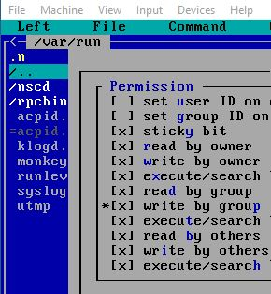


Special Directory Permissions
Sticky Bit (Directory Only):
Anyone can write a file
Only the owner can delete

Slide 12




Slide 13
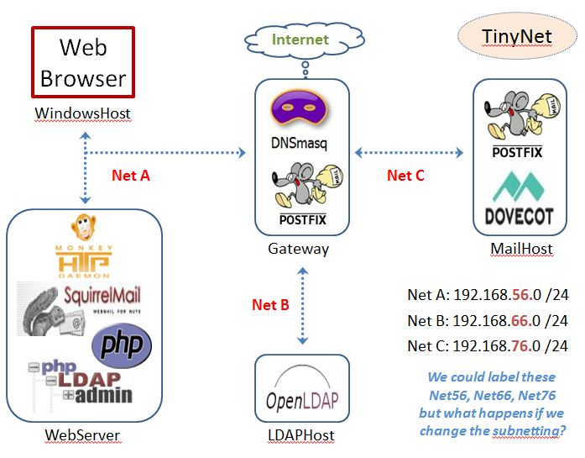
Gateway: One interface for each subnet
HOSTNAME
Is registered
With dnsmasq
Via DHCP
Matched to
Configured
cnames
Broadcast
Domain

Slide 14
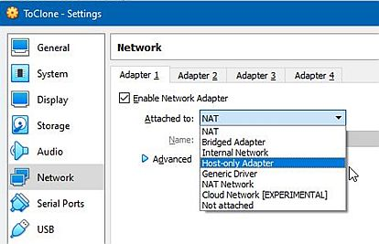
Virtualbox Network Interfaces

Slide 15
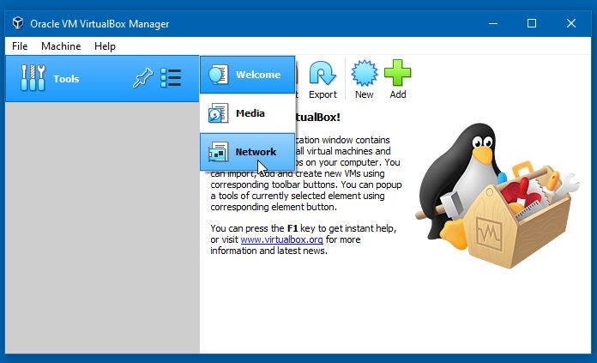
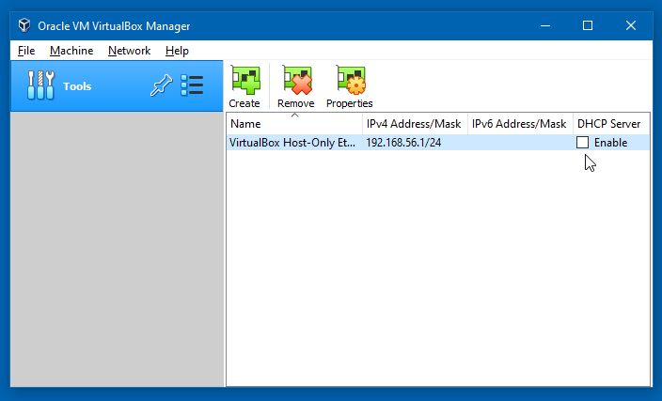
The First Thing to take care of is to Turn Off the VirtualBox internal DHCP server

Slide 16
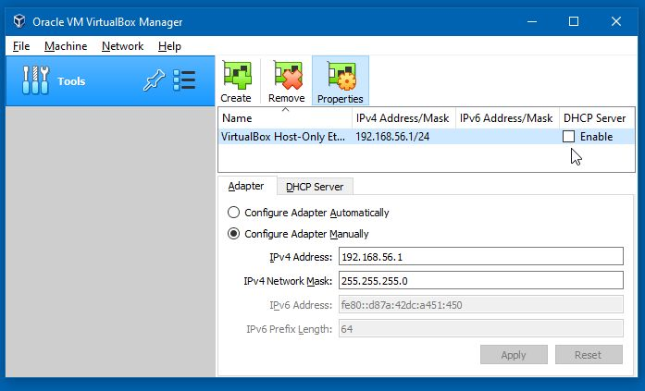
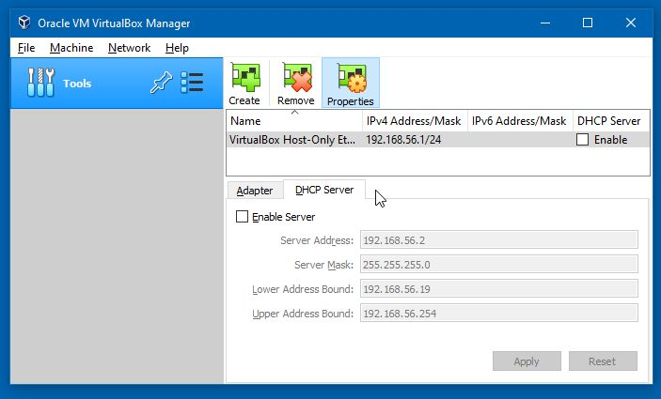
The Next Thing is to Check the IP Address is 192.168.56.1

Slide 17
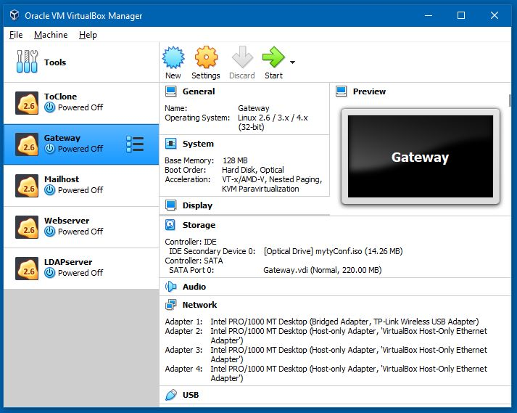
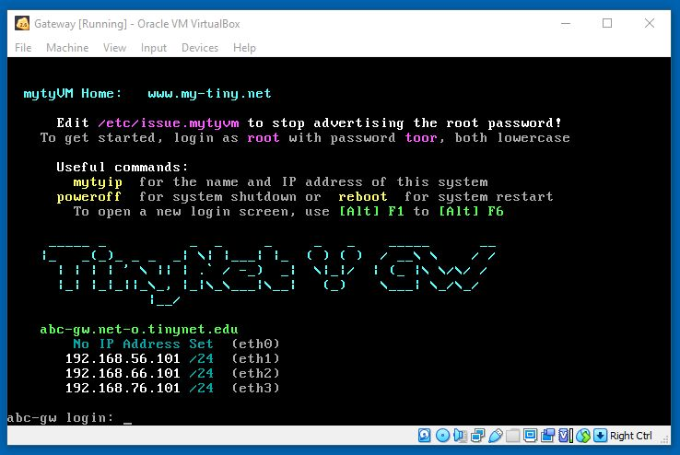
Gateway needs 4 network adapters
1 Bridged
2,3,4 Host-Only
All others have one
Host-Only
Make sure the Gateway is at the login screen before starting the other VMs
(no need to log in)
IP for eth0 on the Gateway depends on your ISP

Slide 18
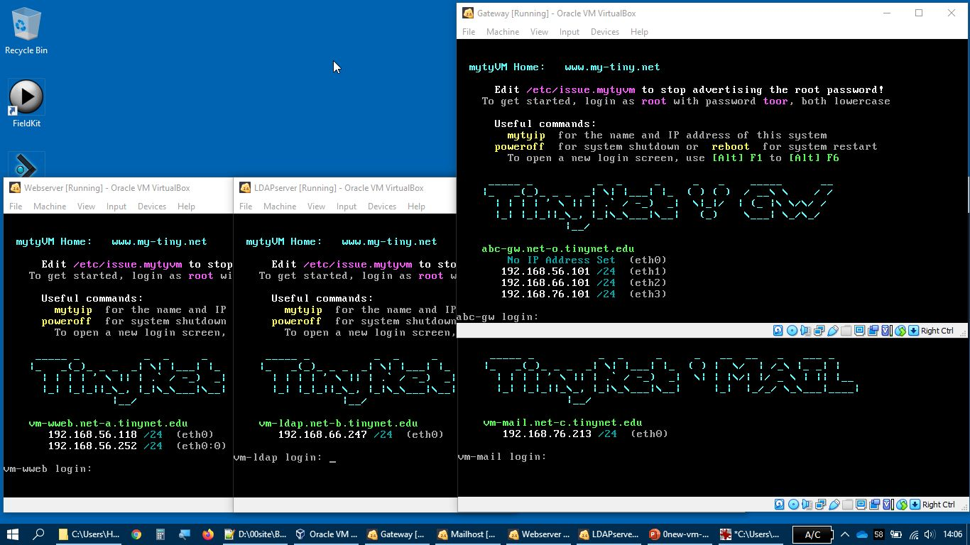
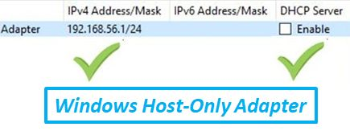
No IP for eth0 on the Gateway is also OK
Web: net-a
ldap: net-b
Mail: net-c
net-a: ..56.+ net-b: ..66.+ net-c: ..76.+
Gateway has an interface for each subnet (net-a, net-b, net-c)
Windows Host-Only adapter and Webserver are on the same subnet

Slide 19
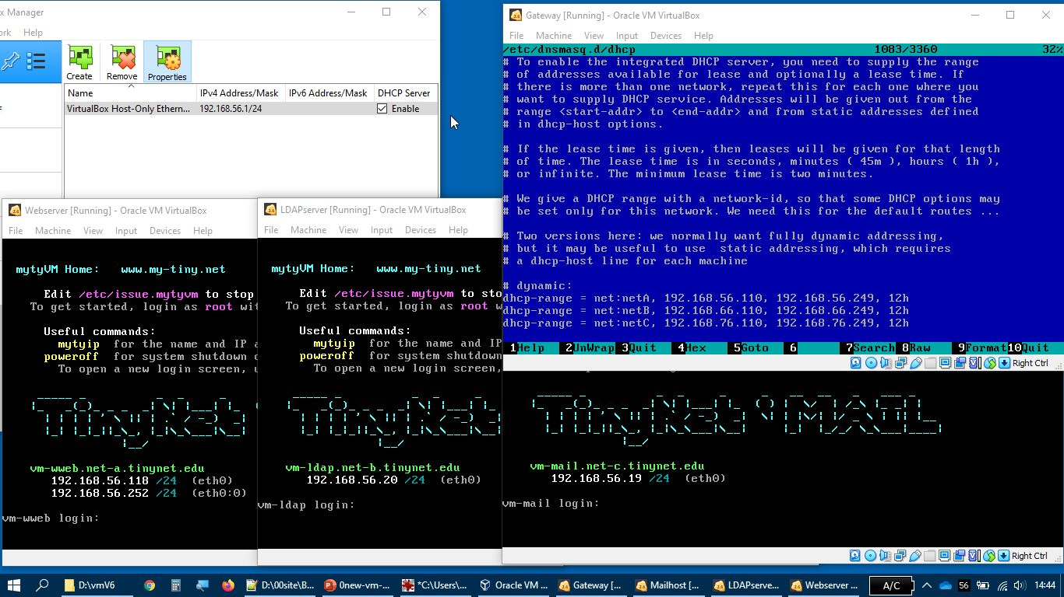


/etc/dnsmasq.d/dhcp
net-a: ..56.+
net-b: ..66.+
net-c: ..76.+
Virtualbox DHCP subverts our subnets!
If Virtualbox DHCP is ON, the Mailserver and LDAPserver get a Net-A address
All of the configurations assume they have an IP address on their proper subnet,
So nothing will work properly!

Slide 20
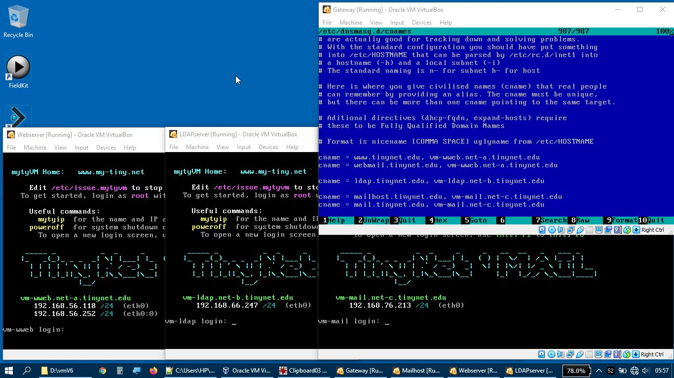
/etc/dnsmasq.d/cnames
cnames allow the DNS to match one IP to several names
Second half of the cnames line must exactly match the HOSTNAME

Slide 21
Troubleshooting the DNS Service
dig or nslookup
Restart after updates to configuration files
Check the logs to familiarise yourself with what it says when it starts
Ensure that the process is running,and listening on UDP (and TCP) port 53 (the domain port)
Run in debug mode
Requires skills of
Mechanic
Sociologist
Researcher

Slide 23
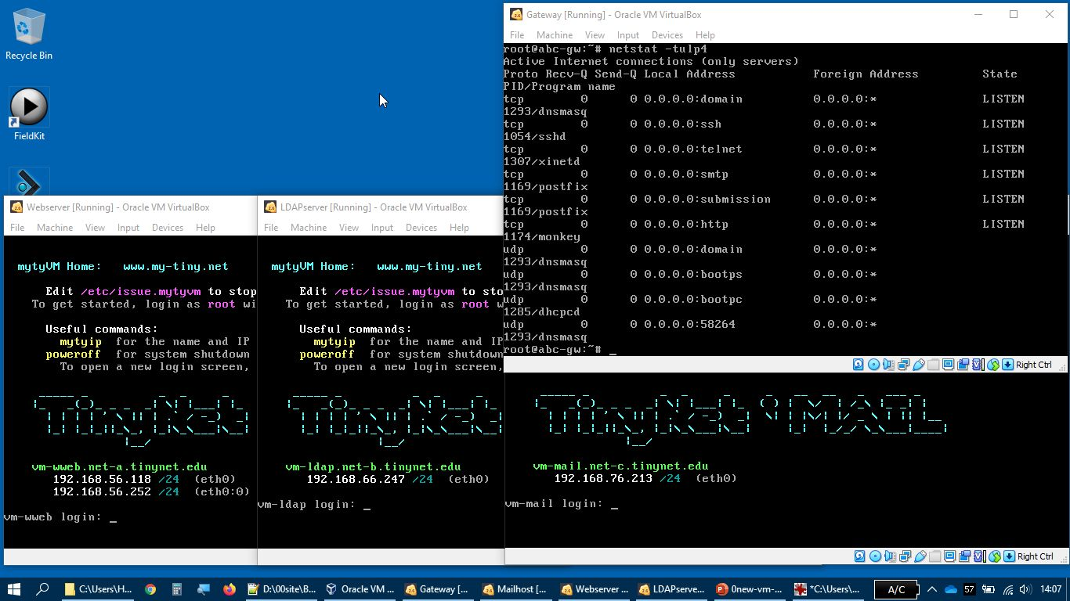
netstat –tulp4
Normal processes and tcp udp listening ports

Slide 24
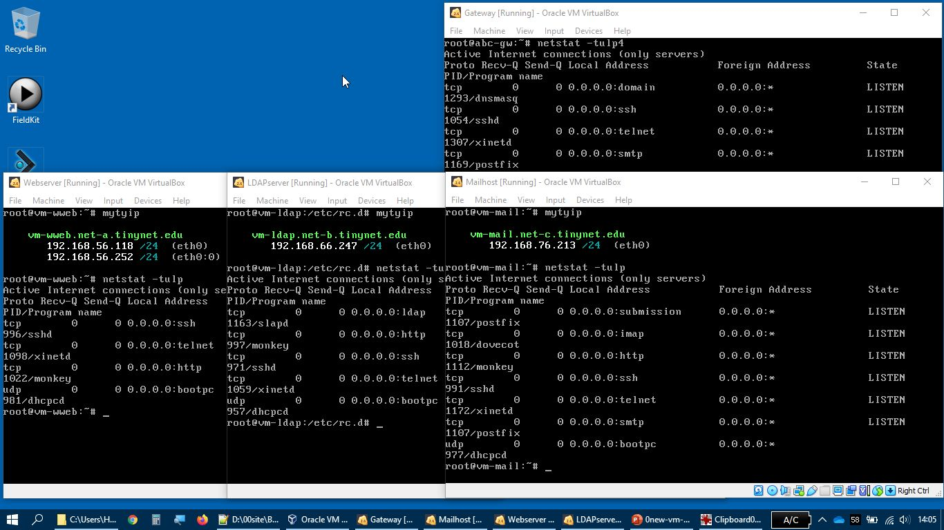
Normal processes and tcp udp listening ports
mytyip
netstat –tulp
http, telnet, ssh run after First Things First
Starting LDAP requires extra steps, postfix and imap run after SetRole
postfix {smtp, submission} runs on both the Gateway and the Mailserver

Slide 25
Work the layers
Play detective:
Interface properly configured?
Ping the gateway?
Ping other hosts by IP address?
Ping other hosts by name?
Temporary Failure in Name Resolution
DNS Problem!
Last half of the cnames line must Exactly Match
the name shown on the server with mytyip
Also – etc/hosts on the gateway: no names without dots

Slide 26
Check the Comptia Videos by Professor Messer link in Moodle if you need some extra review!

Slide 27
Troubleshooting
Use netstat –tulp to check that the port number associated with the service is active
Examine the log with tail /path/to/filename
Restart the service ... (and check the log again)
/etc/rc.d/rc.dnsmasq stop
/etc/rc.d/rc.dnsmasq start

Slide 28
Troubleshooting
4. try the local service – you don’t even need a browser
telnet localhost 80
GET /
Still having problems?
(a) Increase the Loglevel verbosity, for example from...
LogLevel warn to LogLevel debug
(b) Start the process from the shell to capture console logging
Look at the rc.d startup script to find the actual command that is being executed, and run it yourself from the command line

Slide 29


Slide 30
Diagnosis
Requires skills of
Mechanic
Sociologist
Researcher
Play detective:
pay attention to facts
read documentation
talk to others
old bug and problem reports – local and googled
system logs
simple tests and experiments
know your tools, e.g., ping, netstat, ifconfig, ethtool, lsof, locate, tcpdump, wireshark

Slide 31
Change Management
Then change management
decide
map out repercussions
revise policy if necessary, incorporating user comments
inform users of impending change
lock the system to avoid incomplete reconfiguration
make the changes
unlock the system
inform users that all is done
Then revision control for configurations
everything should be documented

